Slide 1

Using Stochastic Local Search to Generate Optimal Pokémon Teams
By: Ethan Hart

Slide 2

Contextualizing Pokémon
An integral part of playing Pokémon is catching and building teams to battle against other trainers
The objective of team-building and battling is to integrate six “optimal” Pokémon into the user’s team and attempt to defeat all of an opposing trainer’s Pokémon
But how should you choose your team? What makes one Pokémon inherently better than another?
Possible team permutations = practically infinite combinations

Slide 3

Goal
The goal of my project was to utilize A.I. techniques to select the most optimal Pokémon team to defeat an opponent’s Pokémon team.

Slide 4

Constraints
With the release of the newest games, upwards of 1000 Pokemon are now in the franchise.
Shortened the sample size down to all fully evolved Pokémon from the original games Pokémon Red Version and Pokémon Blue Version.
Why?
Banned Legendary/Mythical Pokemon from consideration (Mew + Mewtwo)

Slide 5

What is an “Optimal” Pokémon?
Simplified into two categories:
A Pokémon's offensive typing against a defending Pokémon
A Pokémon's statistics (HP, Attack, Defense, Special Attack, Special Defense, Speed)

Slide 6

Methods
Landed on Stochastic Local Search as A.I. method to implement
Small search space
Easy to implement
Avoid same search patterns
Coded in Java

Slide 7

Design
Pokemon.java
Name, Base Stat Total, Types, each stat category
Pokedex.java
Implemented Pokedex database with a HashMap<String, Pokémon>
generatePokedex() method added all fully-evolved Pokémon from Generation 1 to Pokedex
Stats taken from the Pokémon Database

Slide 8
Design (Continued)
TypeEffectiveness.java
Hardest class to implement
Takes in an attacking and defending Pokémon and determines if the attacking Pokémon is super effective against the defending Pokémon
Type chart implemented using 2D Java array - each element of the array contains an effectiveness multiplier (2, 1, 0.5, 0)
IsSuperEffective() determined if an attacking Pokémon is super effective against a defending Pokémon
Four different decision trees of cases to consider!

Slide 9
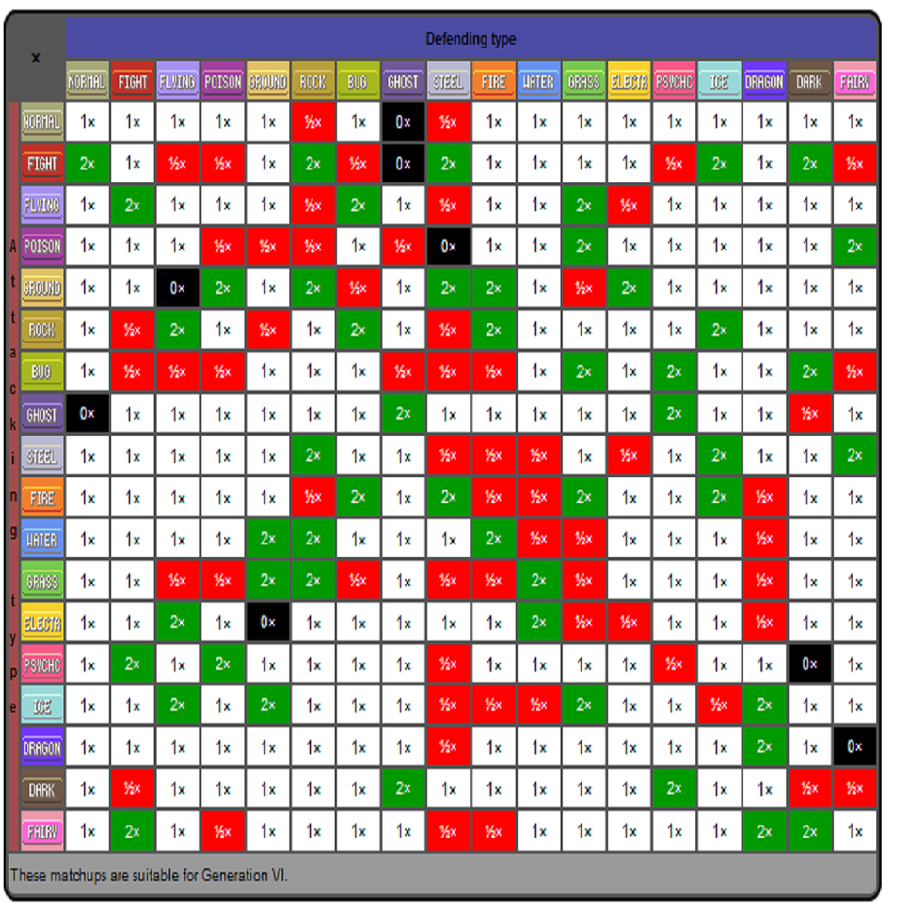

Slide 10

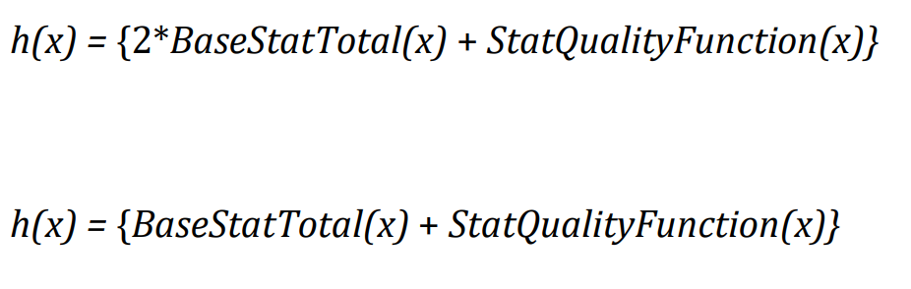
Stochastic Local Search Implementation
Java code implemented from pseudocode on page 122 of A.I.: A Modern Approach textbook
Heuristic function h(x) :
If attacking Pokémon x is super effective
Otherwise

Slide 11
Explanation of Heuristic
I wanted to prioritize Pokémon that were super effective against an opponent
I wanted Pokémon with higher base stat totals to be chosen and rewarded over Pokémon with lower base stat totals
I chose to implement the bonus function StatQualityFunction(x) to reward Pokémon that have several exceptional stat categories

Slide 12
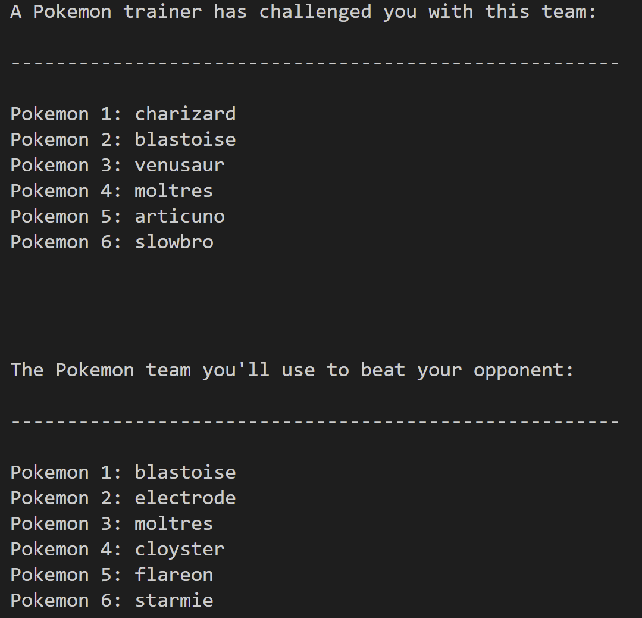
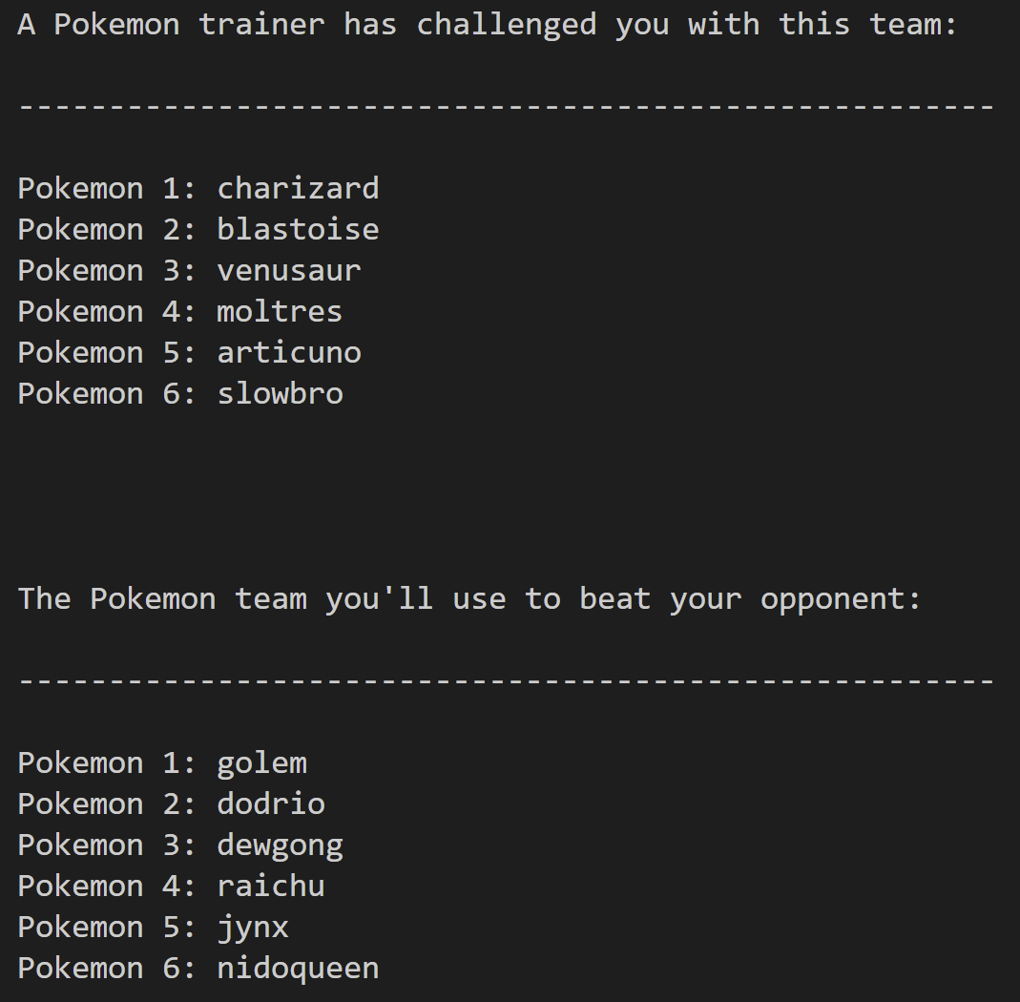
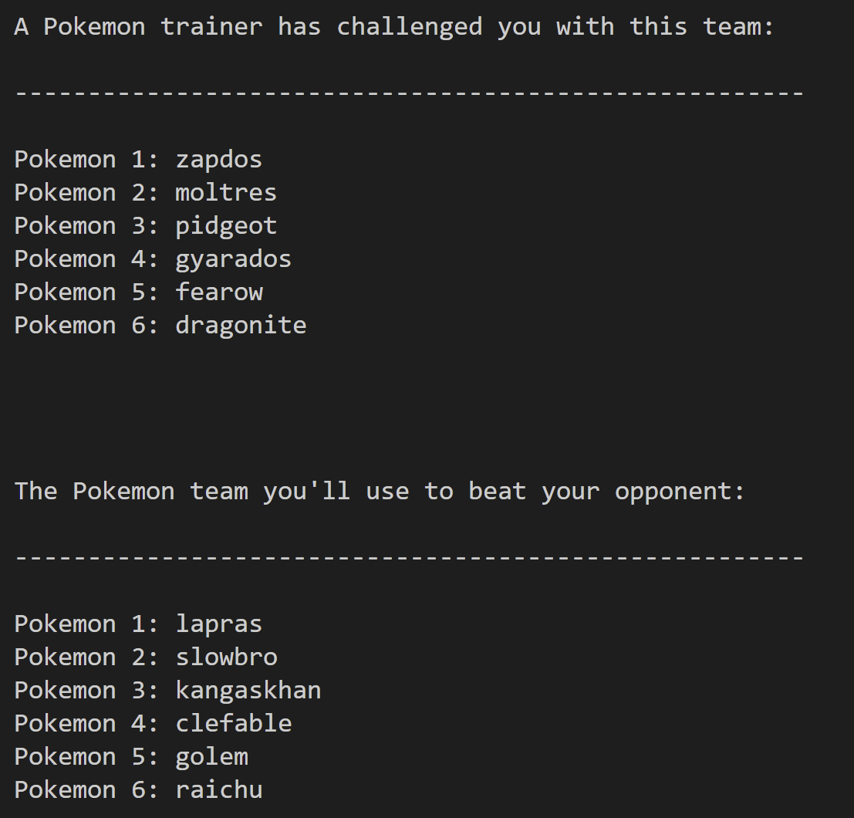
Results

Slide 13

Conclusion
Overwhelmingly positive
Many super effective counter Pokémon chosen
Few cases where instead of a super effective Pokémon being selected, a Pokemon with high base stats that are of high quality are chosen
Only a few times did the search method select a Pokémon that would not be considered wholly optimal (Gyarados -> Clefable Figure 3)

Slide 14
Future Work
More Pokémon in Pokedex
Considering a Pokémon's move pool into score calculation
Implement Simulated Annealing
Consider abilities in score calculation
Consider defensive typing – is your opponent’s Pokémon super effective into your own?

Slide 15

Sources
"Beyond Classical Search." In Artificial Intelligence: A Modern Approach, 3rd ed., edited by Stuart Russel and Peter Norvig, 122-25. Pearson Education, 2010. PDF.
Pokémon Database, ed. "Generation 1 Pokémon Stats." https://pokemondb.net/pokedex/stats/gen1

